Slide 1
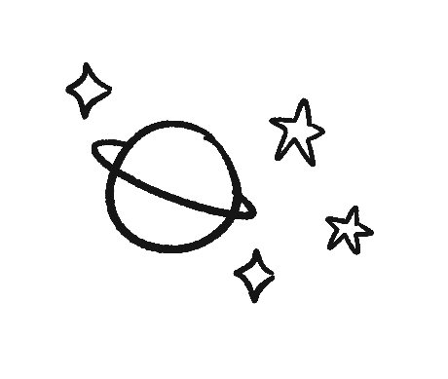
ALL good!
#Genesis 1 UltimateArtist
ORIGINS

Slide 2
WELL good
#Genesis 2 ImageBearers
ORIGINS

Slide 3
NOT good!
#Genesis 3
ORIGINS

Slide 4
ONLY Noah good
#Noah #Genesis 9
ORIGINS

Slide 5
Babel babbler
#YouWhat?
ORIGINS

Slide 6
Serpent crusher
#Genesis 3.15
ORIGINS

